Slide 1
Employee Data Analysis using Excel
STUDENT NAME: VAISHNAVI M
REGISTER NO: 312215894
DEPARTMENT: B.COM ACCOUNTING & FINANCE
COLLEGE: SHRI SHANKARLAL SUNDARBAI SHASUN JAIN COLLEGE
FOR WOMEN

Slide 2
PROJECT TITLE
Employee Performance Analysis using Excel

Slide 3


AGENDA
Problem Statement
Project Overview
End Users
Our Solution and Proposition
Dataset Description
Modelling Approach
Results and Discussion
Conclusion
3/21/2024 Annual Review

Slide 4

PROBLEM STATEMENT
In today's competitive business environment, organizations are constantly striving to maximize productivity and improve employee performance. To achieve this, it is crucial for managers and HR departments to have a clear understanding of the performance metrics of their employees. However, managing and analyzing large amounts of performance data can be challenging without the right tools.

Slide 5

PROJECT OVERVIEW
Enhanced ability to monitor and evaluate employee Performance. Improved decision-making regarding employee development, rewards, and interventions. Increased efficiency in generating performance reports and insights. Greater transparency in performance evaluation processes, leading to more motivated and engaged employees. By leveraging Excel's capabilities for data analysis and visualization, this project aims to provide a scalable and cost-effective solution for employee performance management, supporting organizational goals and fostering a culture of continuous improvement.
.

Slide 6

WHO ARE THE END USERS?
1. Human Resources (HR) Departments
2. Managers and Supervisors
3. Executives and Senior Management
4. Employees
5. Training and Development Teams
6. Compensation and Benefits Teams
7. Consultants and Analysts

Slide 7

OUR SOLUTION AND ITS VALUE PROPOSITION
Your solution leverages Excel to provide a comprehensive, user-friendly, and cost-effective approach to employee performance analysis.
Value Proposition:
1.Cost-Effectiveness
2.Ease of Use
3.Data Management
4.Customizable Analysis
5.Real-Time Analysis

Slide 8
Dataset Description
1. Employee Information
2. Performance Metrics
3. Evaluation Scores
4. Productivity Metrics
5. Additional Factors
6. Data Import and Cleaning
7. Employee classification type
8. Gender code
9. Performance Score
10. Current employee rating

Slide 9

THE "WOW" IN OUR SOLUTION
Interactive Dashboards
Data Visualization
Automated Reporting
Predictive Analysis
Scorecards and Balanced Scorecards
6. Employee Ranking and Comparison
7. Training and Development Analysis
Employee Feedback and Sentiment Analysis
KPI Tracking with Alerts
10. Data Security and Privacy
3/21/2024 Annual Review
9

Slide 10
MODELLING
Data Collection: Data sourced from Edunet dashboard.
Feature Collection: 10 features selected for analysis.
Data Cleaning: Handling missing values.
Calculation of Performance Level: Using employee rating to determine performance.
Summary of Pivot Level: Organizing data using pivot tables.
Visualization: Graphical representation using pivot tables.
10

Slide 11
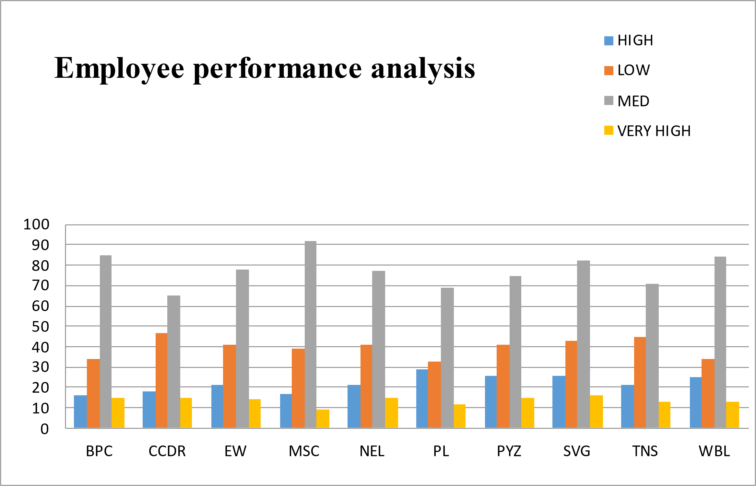
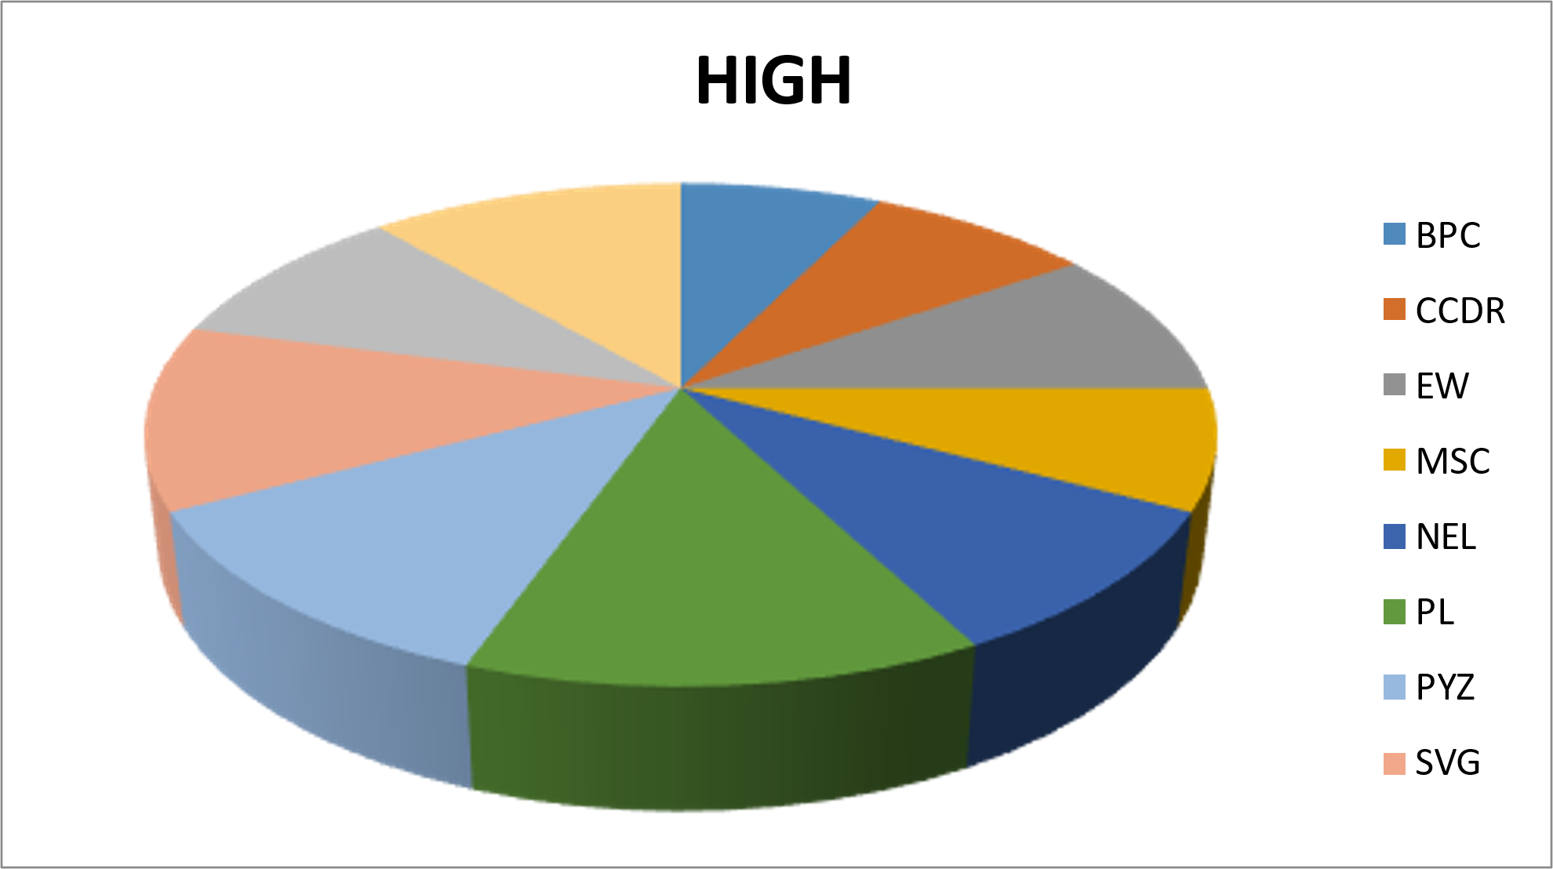
RESULTS
=IF(AND(Z8>=5),"VERY HIGH",IF(AND(Z8>=4),"HIGH",IF(AND(Z8>=3),"MED","LOW")))
11

Slide 12
conclusion
In conclusion, the employee performance analysis using Excel has provided valuable insights into both the strengths and areas for improvement within our workforce. While we have identified a number of top performers who consistently exceed expectations, there are also areas where additional support and resources are necessary to boost overall productivity and satisfaction. By implementing targeted training and feedback mechanisms, we can work towards enhancing the skills and performance of all employees. Moving forward, regular performance reviews and data analysis will be essential in ensuring that we maintain a motivated and high-performing workforce.

